Slide 1

NCJIS Modernization Program
Linda Kennedy, PMP
NCJIS Modernization Program Manager

Slide 2
General Services Division
Responsible for:
  maintaining records of criminal history for the State of Nevada.
Vision
  is “to be the trusted leader in criminal justice information sharing for the State Of Nevada”.

Slide 3
General Services Division
Mission
  is ”to support Nevada’s criminal justice community and its citizens by providing complete, timely, and accurate information in a manner that balances the need for public safety and individuals’ rights to privacy and ensures a positive customer service experience”.

Slide 4
What is NCJIS?
Nevada Criminal Justice Information System
Computerized information system
Source of criminal history of individuals for the State of Nevada
Serves federal, state, and local law enforcement and criminal justice agencies
Reliable, readily available, and adaptable system
Must be easily maintained, enhanced, and supported
Critical to public and officer safety

Slide 5
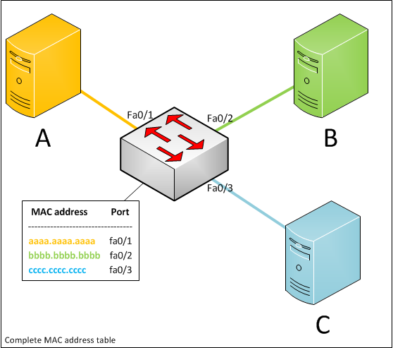

System Description
Multiple software applications
Connected by additional software (JLink)
  Acts as a master switch
  Moves data between the many computer software applications
Uses JClient on a PC
or laptop to access
the information in
the applications

Slide 6
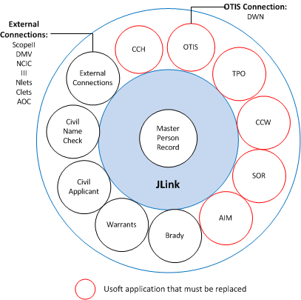
NCJIS
Map

Slide 7
Key to Map
Abbreviation | Definition
JLink | Justice Link message switch
CCH | Computerized Criminal History application
OTIS | Offender Tracking Information System used by Parole & Probation
TPO | Temporary Protection Order data base
CCW | Database of NV persons with concealed weapons permits
SOR | Sex Offender Registry application
AIM | Investigative management system
Brady | Firearms background check application
Warrants | Data base of NV persons with active arrest warrants
Civil Applicant | Fingerprint-based background checks on job applicants
Civil Name Check | Name-based background checks on job applicants
ScopeII | Shared Computer Operations for Protection and Enforcement, Las Vegas Metropolitan Police Department’s local criminal justice system
DMV | NV Dept. of Motor Vehicles data base
NCIC | FBI’s National Crime Information Center
III | FBI’s Interstate Identification Index
Nlets | International Justice & Public Safety Information Sharing Network
Clets | California Law Enforcement Telecommunications System
AOC | Administrative Office of the Courts data base
DWN | Data Warehouse of Nevada

Slide 8
Program History
In 2012 DPS retained MTG Management Consultants, LLC
Developed a strategic plan for long-term improvement
Included systems and subsystems maintained by Nevada Enterprise Information Technology Services (EITS)
Agreed with what was recommended but saw other avenues as to how to implement them

Slide 9
Risks to Citizen & Officer Safety
Server and desktop operating systems as well as tools used to build and support applications are no longer supported by any vendor.
Offender Tracking Information System (OTIS), the current Parole and Probation case management tool, has functional gaps leading to keeping those under probation supervision too long and possibly releasing parolees too early.
Protection order files only contain protection orders issued for domestic violence and not for the other types of protection orders.

Slide 10
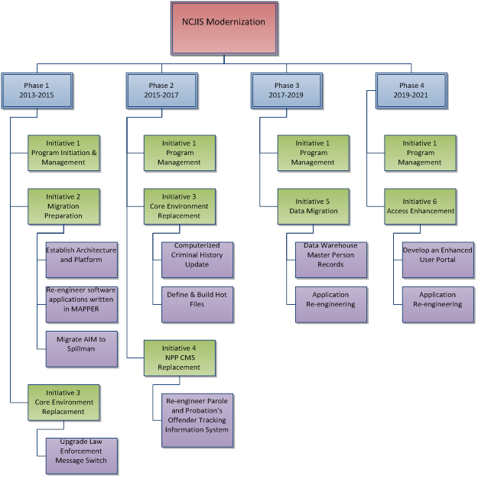
Long-Term Plan

Slide 11
Current Biennium—2013-2015
Initiative 1—Program Initiative & Management
  Establishing a governance framework
  Implementing stakeholder communication plan
Initiative 2—Migration Preparation
  Establish Architecture and Platform
    SAG implementation
    EITS training
    Pilot
  Re-engineer software applications written in MAPPER
  Migrate AIM to Spillman
Initiative 3—Core Environment Replacement
  Upgrade Law Enforcement Message Switch
    Architecture Upgrade
    Software Update
    User Acceptance

Slide 12
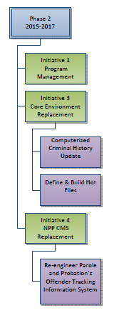
Next Biennium—2015-2017
Initiative 1—Program Management
Initiative 3—Core Environment Replacement
  Computerized Criminal History (CCH) Update
  Define & Build Hot Files
Initiative 4—Nevada Parole and Probation CMS Replacement
  Re-engineer Parole and Probation’s Offender Tracking Information System

Slide 13
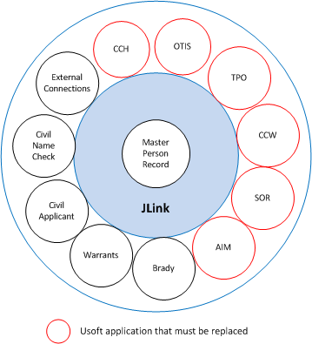
Future Biennium—2017-2019
Initiative 1—Program Management
Initiative 5—Data Migration
  Data Warehouse Master Person
  Application Re-engineering

Slide 14
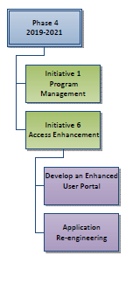
Future Biennium—2019-2021
Initiative 1—Program Management
Initiative 6—Access Enhancement
  Develop an Enhanced User Portal
  Application Re-engineering

Slide 15
Benefits
Provide an environment capable of meeting changing state and federal standards and requirements
Provide a reliable environment for the justice community
Provide a system of independent linked systems
Provide the ability to extend the system’s useable lifespan
Provide browser agnostic solutions to extend the system’s useable lifespan

Slide 16
Benefits
Minimize replacement costs
Minimize maintenance costs
Minimize training costs
Provide required data to authorized personnel in a timely manner
Improved access to information
Reduce errors caused by data entry redundancies
Increase efficiency

Slide 17

Questions

